Slide 1
NHS England Health & Justice Children Programme
Andrew Nichols-Clarke
Senior Development Lead
Health & Justice Children Programme
NHS England

Slide 2
Our cohort: children with complex needs
This cohort of children often have complex needs in multiple domains and are sometimes described as “high risk, high harm, high vulnerability”. They may:
Have a higher likelihood of having been subjected to Adverse Childhood Experiences (ACEs)
Have challenges in developing secure attachments.
Have experienced high levels of social disadvantage.
Have multi-layered, unmet and complex needs.
Not be accessing services in a timely manner in the first place, despite high levels of need.
Have a higher likelihood of having been subjected to trauma or severe neglect.
* P 51 NHS Long Term Plan Para 3.29

Slide 3
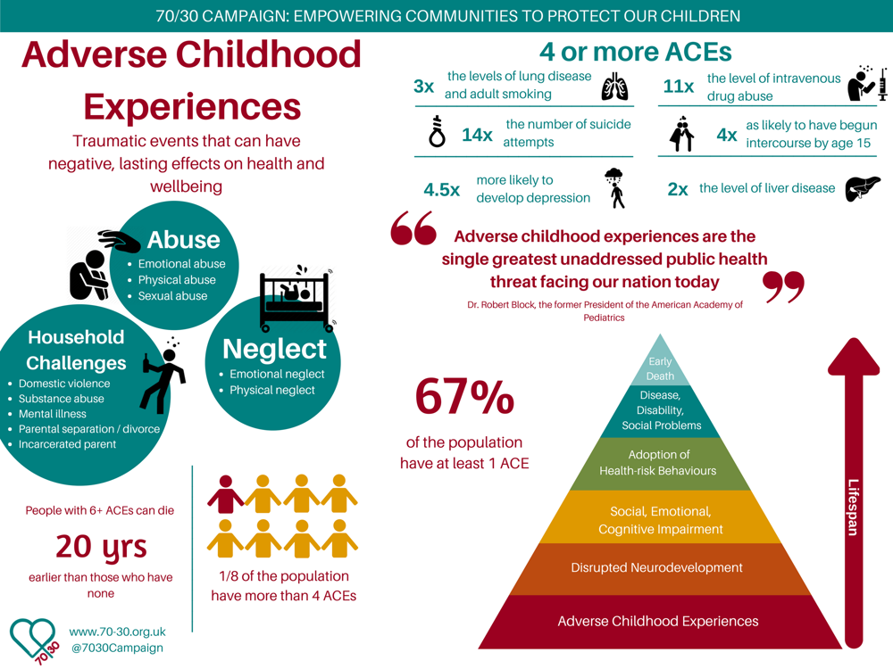

Slide 4

Children and young people with complex needs
The below data is from children on justice placements, however indicated by the 2018 review into young people’s secure care, despite the notional clarity of the three components of secure care, children placed in all three types of secure setting often shared similar, disadvantaged backgrounds and characteristics, including mental health difficulties
2009
2019
Mental health: A third (33%) of children in custody were recorded as having mental health concerns, with a higher proportion for girls (41% compared to 33% of boys).
Education: Over 60% were not engaged in education prior to entering custody.
Learning disability: A third (32%) were recorded as having a learning disability or difficulty (compared to 18% in the general population).
Substance misuse: 45% were recorded as having substance misuse concerns.
Looked after children: 49% were recorded as currently being or having previously been a looked-after-child.
[Figures based on analysis looking at new admissions to custody between April 2014 – March 2016.]
Custodial sentences of over 12 months
20%
35%
Violence against the person offences
16%
23%
Remand custodial population
19%
28%
Data Source: Key Characteristics of admissions to youth custody (2017); Criminal Justice System Statistics Quarterly: December 2019; 2011 census; Assessing the needs of sentenced children in the YJS 2018/19

Slide 5
Children with complex needs
Because of their vulnerability and high level of health inequalities this cohort of young people are often placed in a secure setting (deprivation of liberty) as a result of their behaviours and what has happened to them.
Children can be deprived of their liberty in England under one of three legal frameworks:
Section 25 of the Children Act (1989) placing them in a secure children’s home;
Under the Youth Justice System on remand or serving a sentence in a secure children’s home (SCH), secure training centre (STC) or young offender institution (YOI);
The Mental Health Act (1983, as amended 2007) placing them in hospital.
Placement in the children and young people secure estate is temporary, and part of a broader pathway of care. The Framework for Integrated Care (Community)* considers the needs of those who are at risk of entering the welfare, youth justice or mental health inpatient estate. It focuses on services working together in a more integrated way, and intervening early to best meet and deliver the needs of children with the most complex needs.

Slide 6
Services often working with this cohort of children
Education
Physical Health Services
Police
Social Care
Local Authority
Youth Offending Teams
Liaison & Diversion Services
Mental Health Services
Voluntary Sector Services

Slide 7

How do we work better with these children to support their needs and help them to thrive.

Slide 8
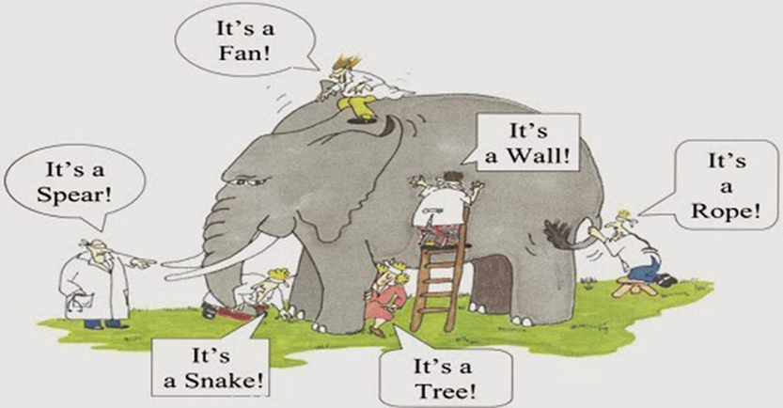
A Shared Understanding

Slide 9

Changing the Fundamental Question
“Its not what’s ‘wrong’ with them? (& Us)
“Its what has happened to them? (& Us)
“When we truly understand the story, everything becomes understandable”

Slide 10
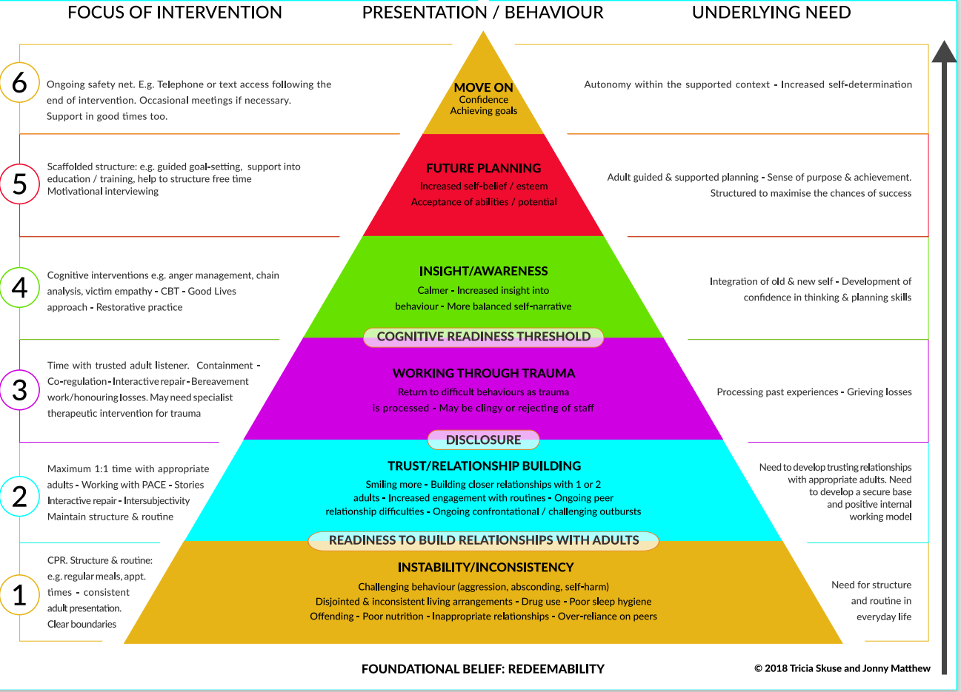

Slide 11
Services working better with this cohort of children
Education
Physical Health Services
Police
Social Care
Local Authority
Youth Offending Teams
Liaison & Diversion Services
Mental Health Services
Voluntary Sector Services

Slide 12
Framework for Integrated Care: a system approach
The Framework for Integrated Care provides a set of guiding principles and practices, that act as a template for genuine co-production and development of integrated services for children and young people with complex needs;
It represents a shift in ideology, moving away from approaches that seek to fix ‘what is wrong with you’ to approaches that seek to understand and address ‘what has happened to you’;
The Frameworks, both SECURE STAIRS and Community, aim to provide a ‘scaffold’ for innovative working practices and collaborations across systems and partners to enhance services that seek to prevent re-traumatisation and enable children and young people, with complex needs, to thrive;

Slide 13
The Framework for Integrated Care (Community) - Principles
1. Every Interaction Matters: There is a focus first on building and supporting positive collaborative relationships.
2. Children & young people and the relationships they experience are at the centre of all care they receive through genuine co-production.
3. Those spending most time with young people are the primary facilitators of change.
4. Positively influencing the day to day care is the basis of any intervention and the primary focus of support.
5. All behaviour is understandable in context; there is a focus on developing an understanding of each children & young people's behaviours and needs based on their story (Formulation).
6. There is a commitment by all to build and sustain trauma informed organisations.

Slide 14
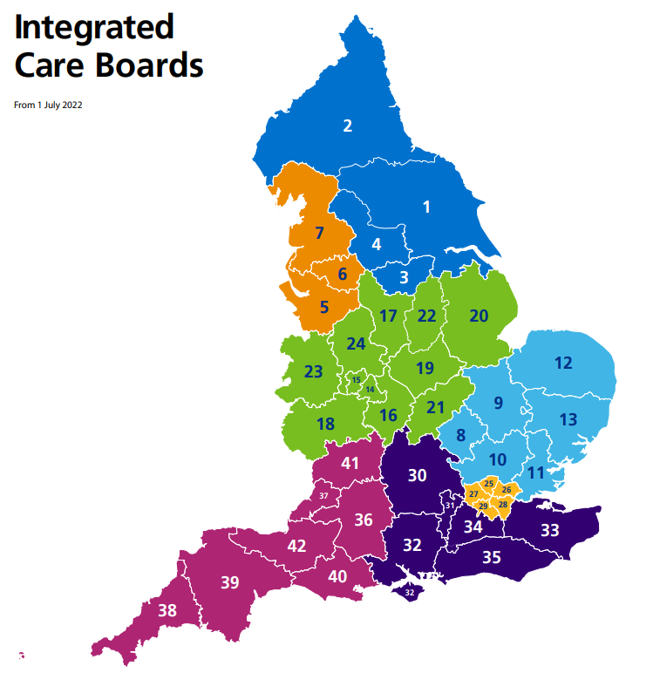
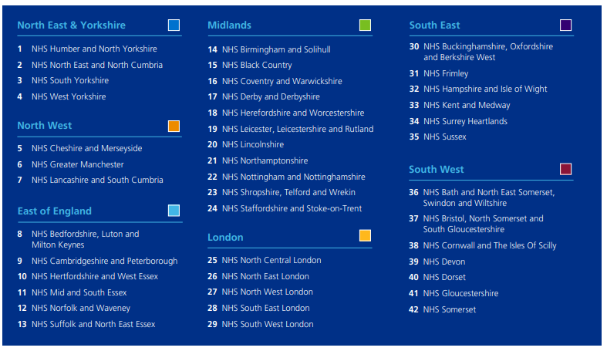
https://www.england.nhs.uk/wp-content/uploads/2022/05/integrated-care-boards-map-may-2022-v1.2.pdf

Slide 15
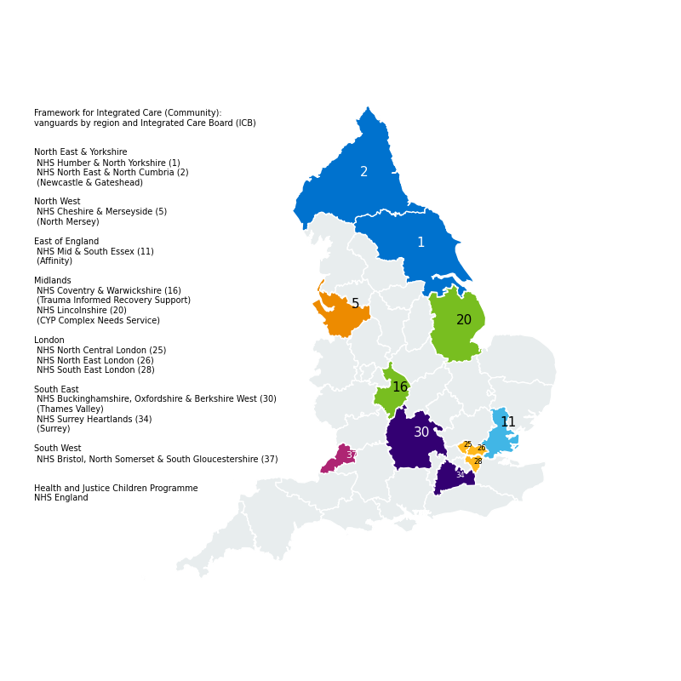
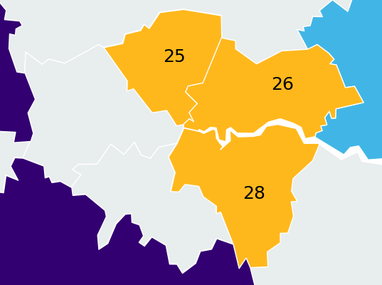
Framework for Integrated Care (Community):
vanguards by region and Integrated Care Board (ICB)
London

Slide 16

A framework for greater collaboration, heath promotion and use of physical activity and sport across the welfare and justice systems.

Slide 17
The agreement focuses on the use of physical activity and sport across the following five areas:
Early Intervention – Preventing harm, improving mental health and emotional wellbeing and ensuring that children, young people and adults receive the help they need to thrive.
Prevention and diversion – Increasing targeted activities and wraparound support to reduce entrants into the youth and adult secure estates.
Non-custodial sentences – Prioritising health and wellbeing to prevent further offending and supporting the welfare of children, young people and adults.
Custody – Increasing health and wellbeing-related purposeful activity, skills and opportunities that, where possible, can be continued on release into the community.
Continuity of care – Supporting social inclusion, recovery from substance misuse, improved physical and mental health and desistance from crime.

Slide 18
Thank you for listening
Any Questions?
Andrew.nichols-clarke@nhs.net

