Slide 1

Notes:
the-role-and-value-of-pe-and-sport-in-alternative-provision-schools-final-report-september-22.pdf (youthsporttrust.org)
Providing-the-Alternative-Final-V.pdf (centreforsocialjustice.org.uk)
https://podcasts.apple.com/us/podcast/276-the-role-and-value-of-pe-sport-in/id1434195823?i=1000602072834
There is also a brief blog here: https://www.leedsbeckett.ac.uk/blogs/carnegie-xchange/2022/11/the-challenges-of-delivering-physical-education-in-alternative-provision-schools/

Slide 2

Working with PRUs & Alternative Provision
Chelsea Piggott- StreetGames
Graham Helm-StreetGames
Notes:
2021- 32,083 pupils in alternative provision/ 761 settings
81% of pupils are on the SEND register, 6x more likely that mainstream
47% Free School Meals compared to 14% of mainstream
Over 55% of prison population were excluded from mainstream school.

Slide 3

Tom Quarmby
Leeds Beckett University
‘’Appetite and Barriers of Sport within AP’s and PRUs’
WATCH HERE

Slide 4
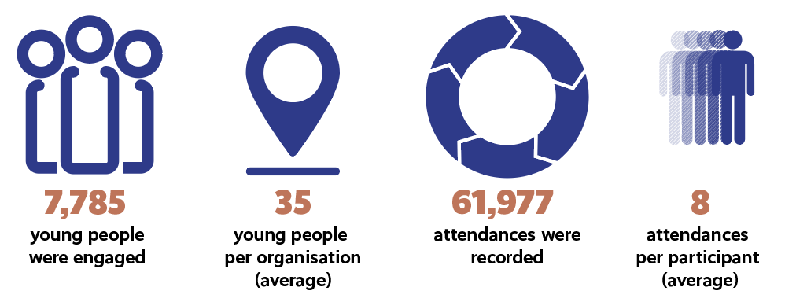
Notes:
Our appetite to work with AP/PRUs
Across the 220 organisations, we have:

Slide 5
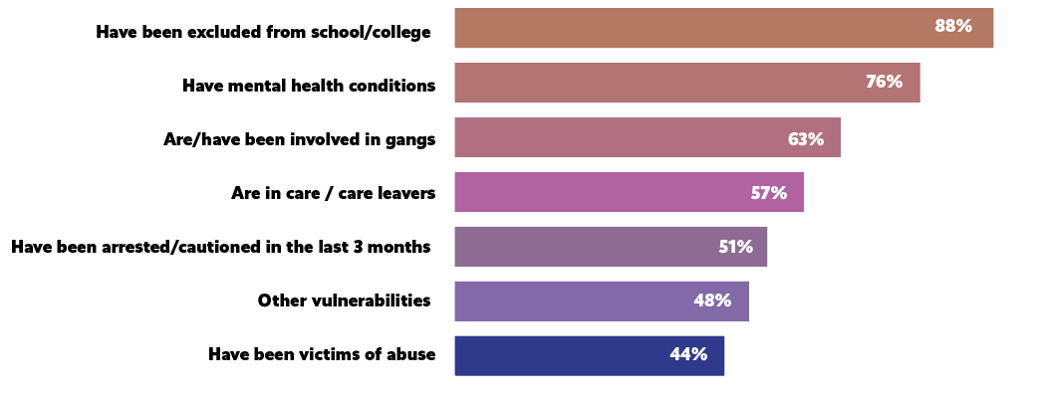
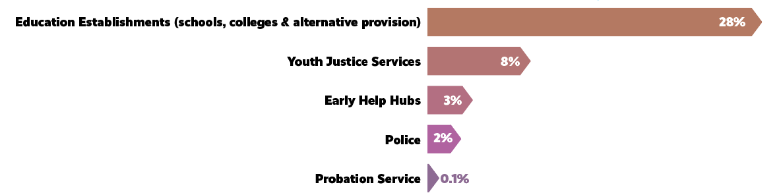

Slide 6

Caroline Fallis-Taylor
UDOIT Dance
Contact: Caroline Fallis Taylor caroline@udoitdance.co.uk
Notes:
Contact: Caroline Fallis Taylor caroline@udoitdance.co.uk

Slide 8
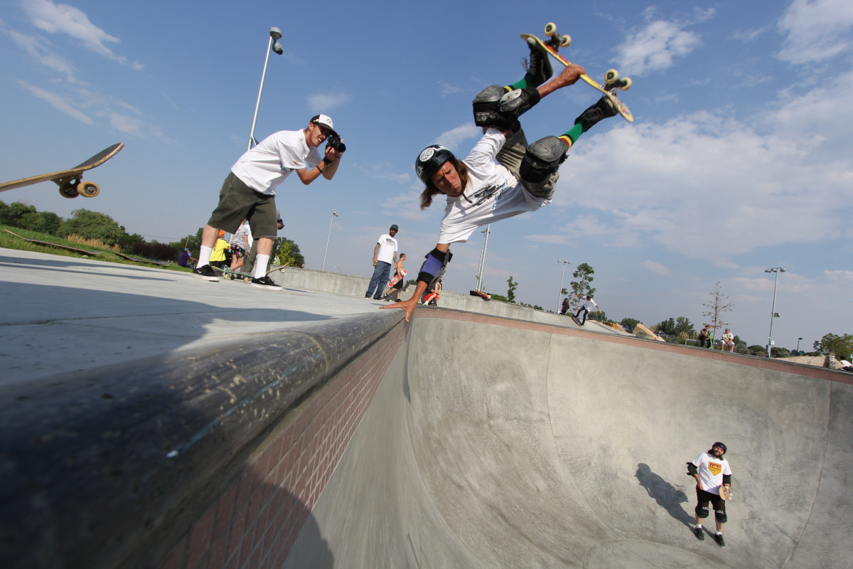


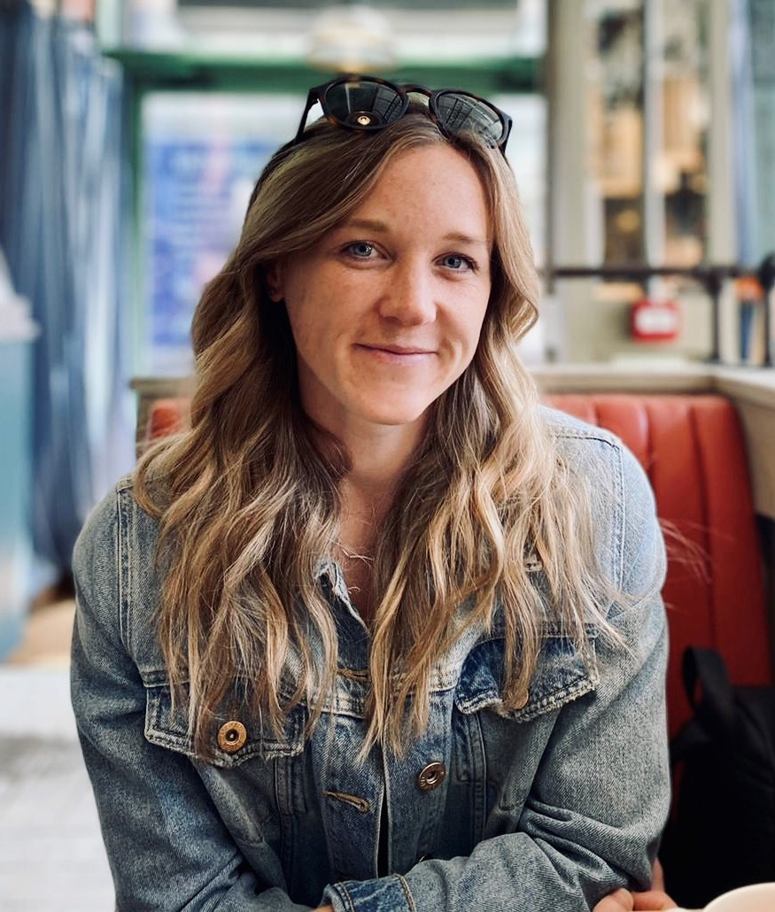
You are being invited to participate in research to understand how organisations use sport and physical activity programmes to deliver life skills to young people.
The research consists of completing a simple survey, containing mainly tick boxes, and should take no longer than 10-20 minutes.
Any personal information shared will only be seen by the University research team.
SCAN ME
Chelsea Piggott
StreetGames | Sport and Violence Impact Manager
PhD Student | Loughborough University
C.Piggott@lboro.ac.uk

