Slide 1


Slide 2
Telling your story through the power of evidence
Claire Khan & Charlie Spencer
27th April 2023

Slide 3
Todays Session
  Why do we need to take an evidence based approach to telling stories?
  What information underpins the stories we tell?
  Review a case study to better understand the potential that exists in the YJSF data, both as an individual organisation and as part of a national network
  How can you use the project data to connect into your local YJS.

Slide 4








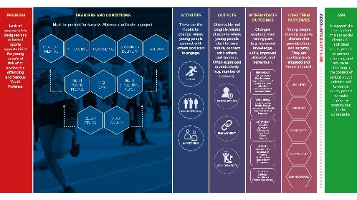

Why do we need to take an evidence based approach to telling stories?

Slide 5
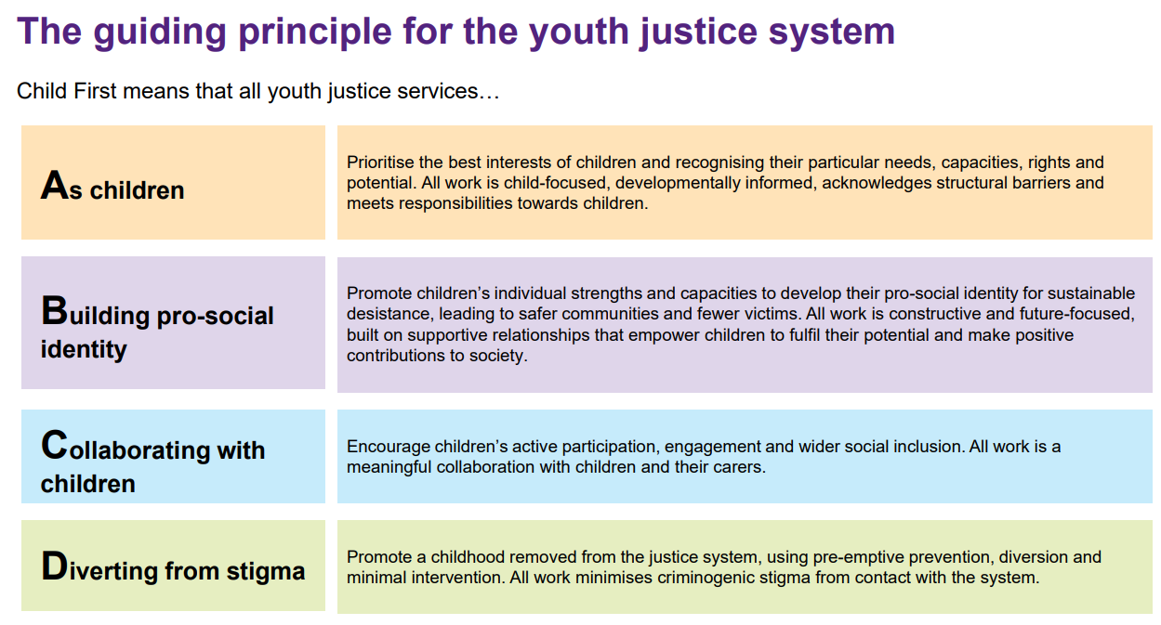






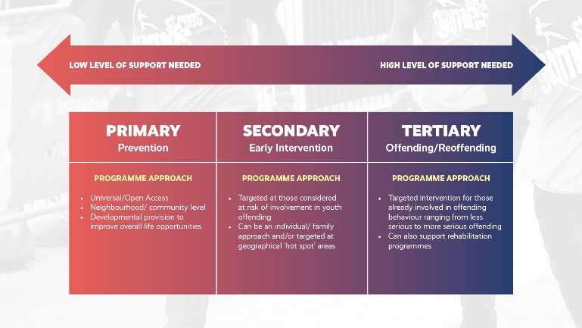
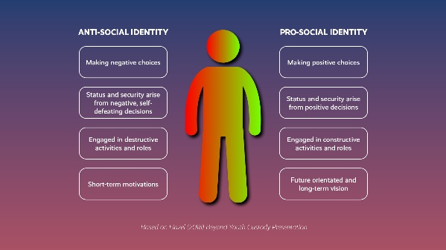



What information underpins the stories we tell?
Existing KPI’s Offending rate & frequency
First Time Entrants
Use of custody
Additional KPI’s (April2023) Accommodation
Education, training and employment
SEN, learning difficulties Mental health & wellbeing
Additional KPI’s conti……
Out of court disposals Links to wider services Management board attendance Serious violence Victims
TURNAROUND
SCHEME

Slide 6
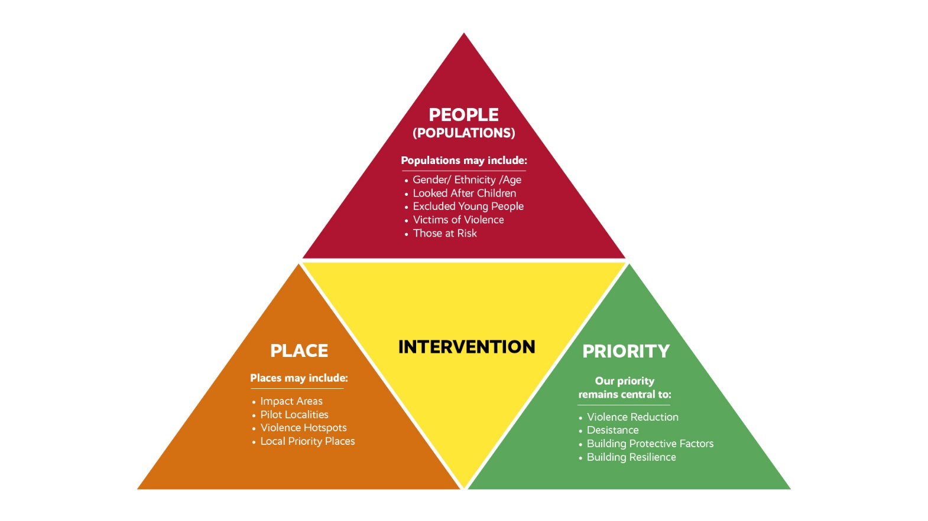


Case Study

Slide 7
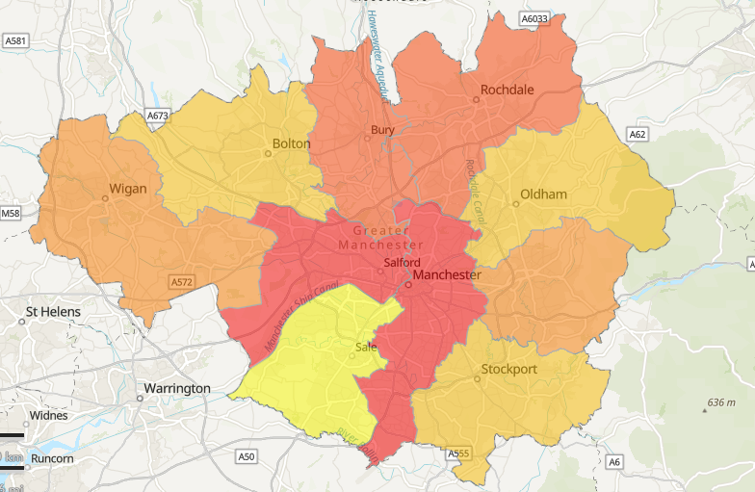
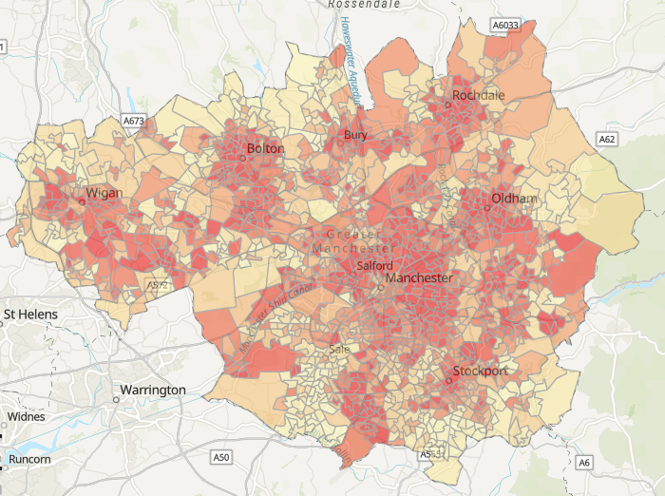
Case Study
YJSF DATA
Place – Manchester (LSOA – 1,500 people)
  IMD 1
  IDACI 1
  52% of 0-15 year olds in this community are living in relative low income
  The community is ranked in the 20% (440) incidents/annum) across Manchester for 4 indicators of crime:
    All recorded crime (GMP)
    Violent crime, (GMP)
    A&E attendances by victim home address
    A&E attendances by estimated location of incident
    Ambulance call outs due to assault (GMCA, 2021/22)
  Education data, 68% FMS eligibility, 72% EAL, 25% achieve grade 5 or above in Maths and English at GCSE
  The population ethnicity (Census 2021)
    46% white
    20% black
    22% Asian
    8% mixed
    4% other

Slide 8
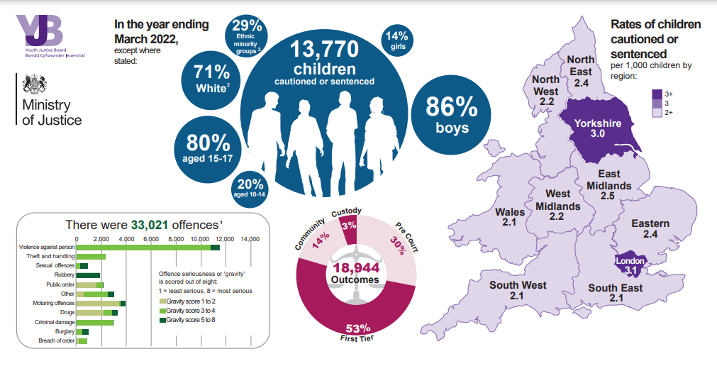
Case Study
YJSF DATA
People
Reach
  23 young people (YP) engaged
  Age – 58% 15-17 years old , 42% 10-14 years old
  Ethnicity – 57% of cohort were black, 13% mixed, 30% white
  Gender – 84% male
  Vulnerability (secondary cohort)
  Excluded from school
  Arrested in the last 3 months
  Have been involved in gangs
  Are in care
  Pathways
  40% YP referred through formal pathways, Youth Justice & Education
  60% YP reached the session via informal pathways
  Non attendance data
  Phone calls with parents or statutory service
  Made changes to the group dynamics, made transport available, and changed the time
  Safeguarding
  Neglect, behaviour, domestic abuse, bullying

Slide 9
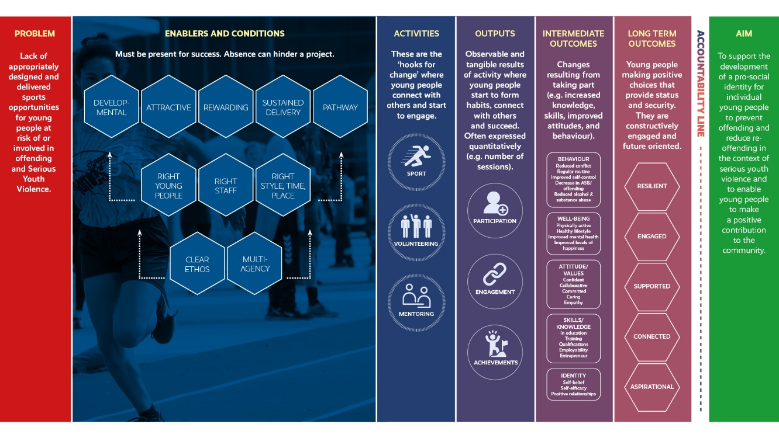
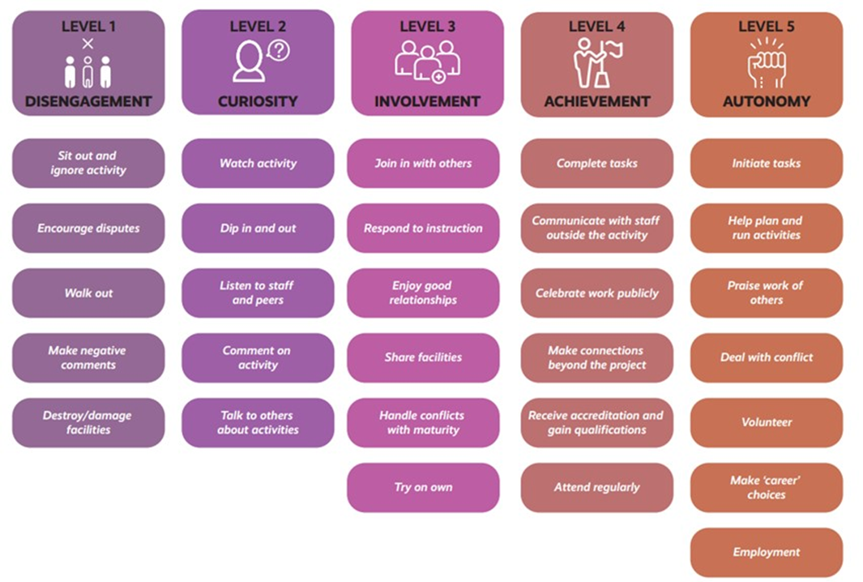
Case Study
YJSF DATA
  Priority (outcomes)
    Staff : Young People Delivery Ratio
      sport (1:10)
      sport plus (1:4)
    Average number of sessions attended = 9 (hours to include sport, sport plus & pastoral)
    Football, basketball, multi-sports, fitness
    Mentoring, 1:1 youth work, volunteering, food, qualification
    Engagement
      Average 1st reading = 2.5
      Average 2nd reading = 3.1
    Achievement: qualifications/ training

Slide 10
The Opportunity
Motivate and inspire children onto a positive pathway
Impact on the safety and well-being of children and wider communities
Inform local youth justice strategy and programme delivery
Help children to navigate away from exploitation and violence
Demonstrate your contribution to achieve YJB key performance indicators
Ability to demonstrate ‘what works’
Tell the story in terms recognised by Youth Justice Services( or YOTS) YJB and MOJ
Build the case for more strategic and operational influence in youth justice policy and practice, built on evidence
Create opportunities to forge strong partner relationship with your local youth justice team

Slide 11
THANK YOU

