Slide 1
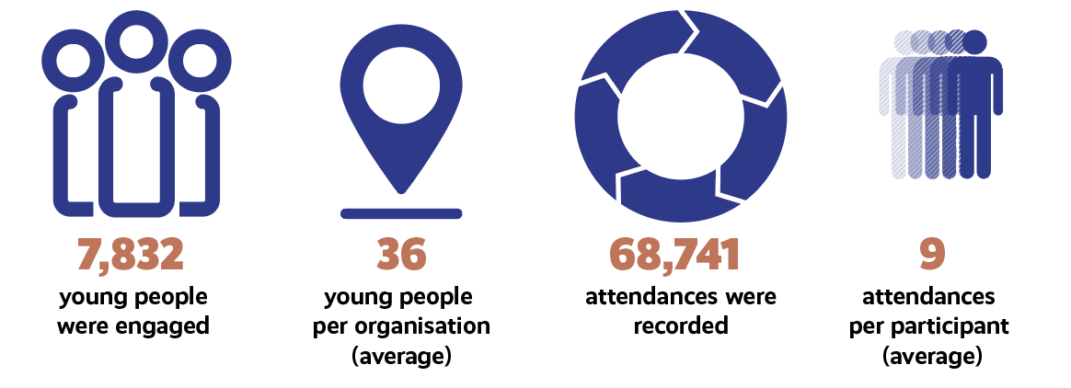
Young People Engaged
Notes:
From Views/Upshot Monitoring data - as at 31/03/23

Slide 2
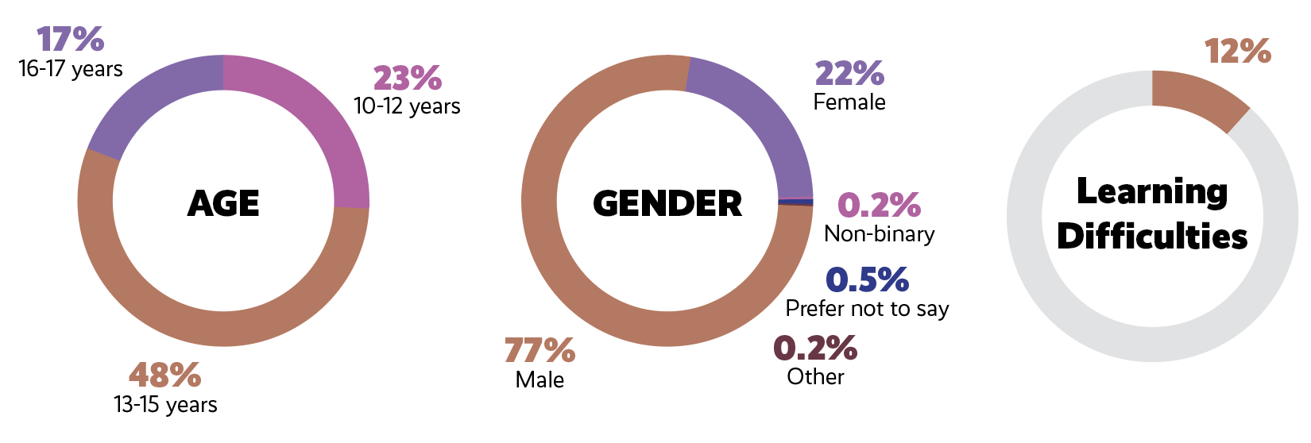
Demographics
Notes:
From Views/Upshot Monitoring data - as at 31/03/23

Slide 3
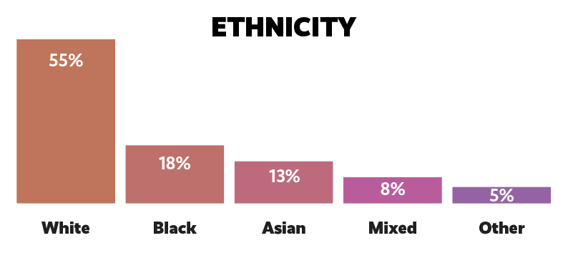
Notes:
From Views/Upshot Monitoring data - as at 31/03/23

Slide 4
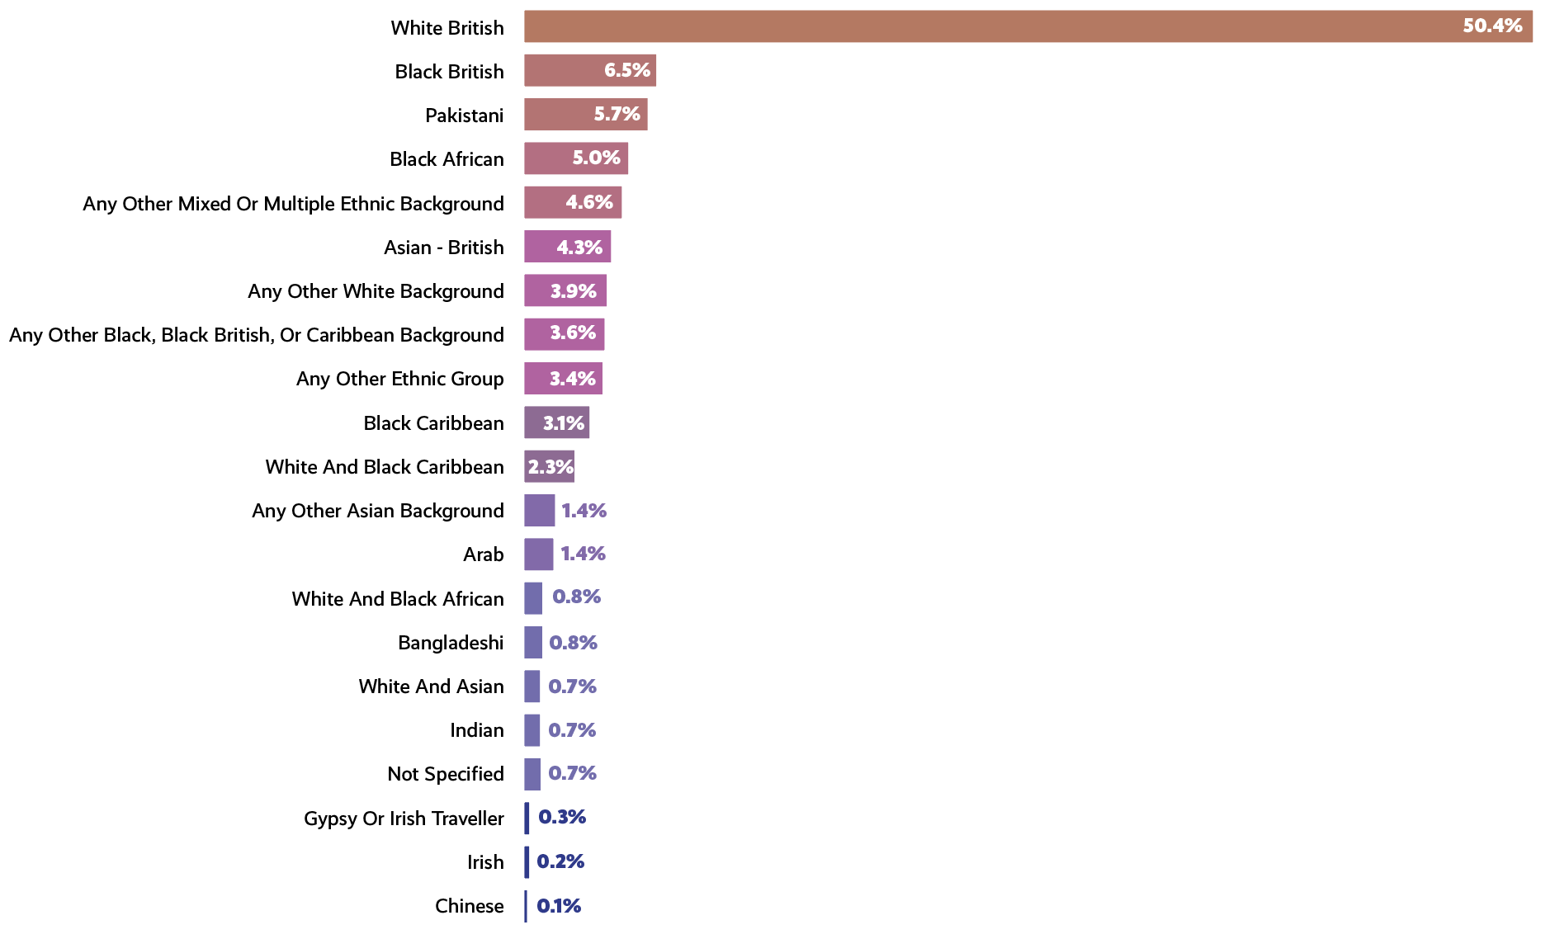
Ethnicity
Notes:
From Views/Upshot Monitoring data - as at 31/03/23

Slide 5
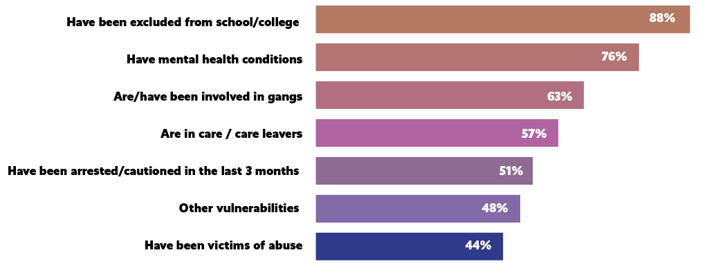
Vulnerabilities
Notes:
Data from Project Survey - N.B. this is NOT individual YP monitoring data…So it does NOT mean 88% of the YP engaged were excluded from school or college, but that 88% of organisations had engaged some YP who had been excluded from school & the other vulnerabilities .

Slide 6
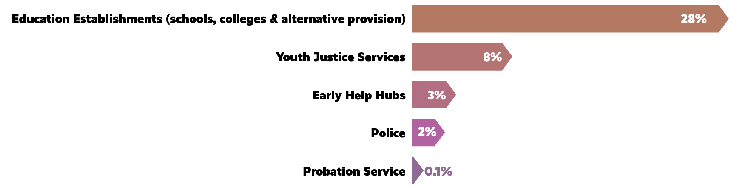

Referral Routes
Notes:
From Views/Upshot Monitoring data - as at 31/03/23. The referral routes of 682 (9%) of young people were not specified.

Slide 7
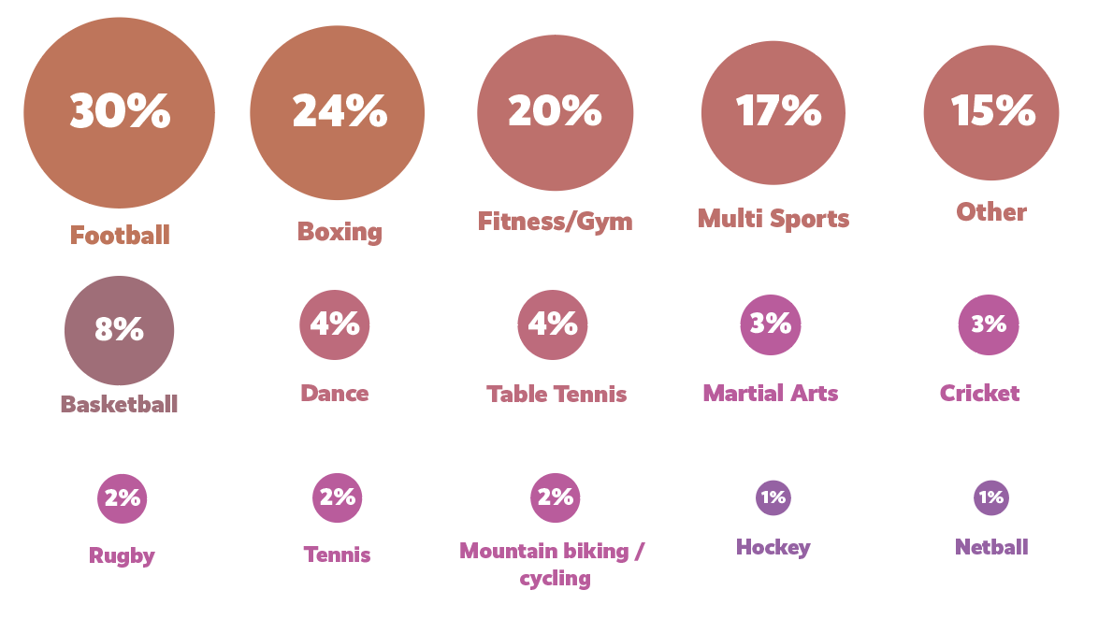
Sports Activities
Notes:
These are the most popular activities…many others were also provided including: rounders, golf, SCUBA diving, dodgeball, climbing, trampolining, horse riding, ice skating, parkour, calisthenics, pool, fishing, walking, gymnastics.

Slide 8
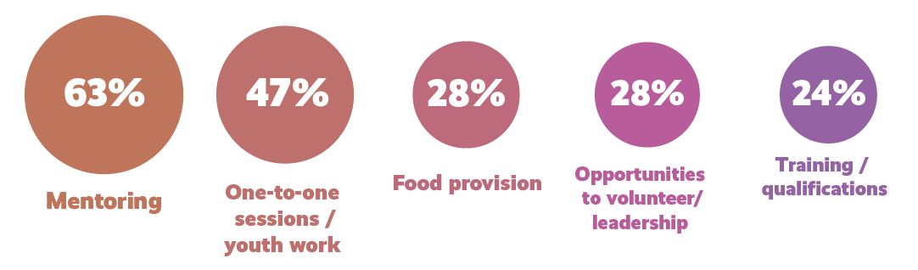
‘Plus’ Activities

Slide 9
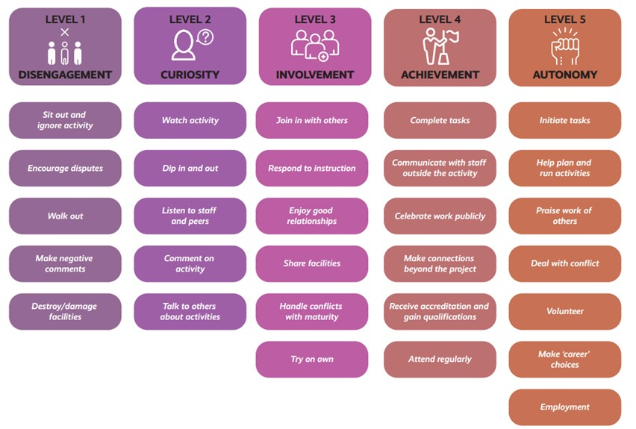
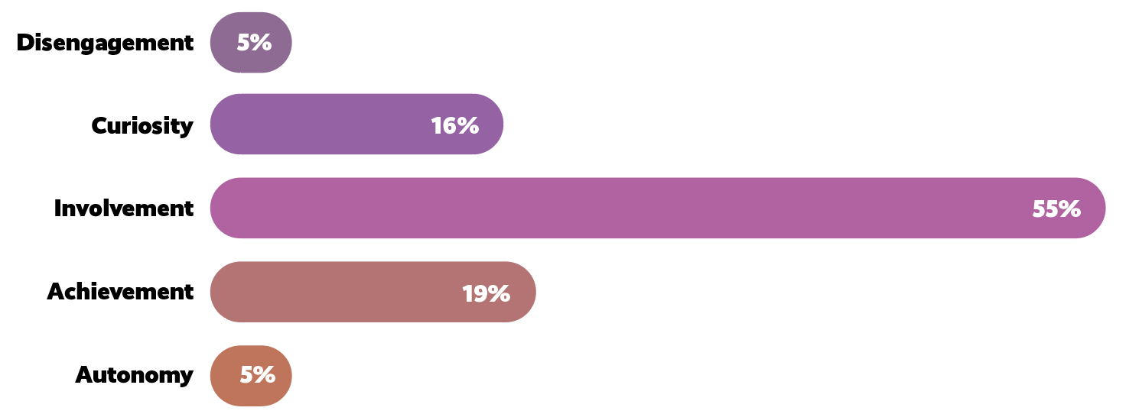
Engagement Levels
Notes:
From Views/Upshot Monitoring data - as at 31/03/23. From 20,105 engagement level recordings

Slide 10
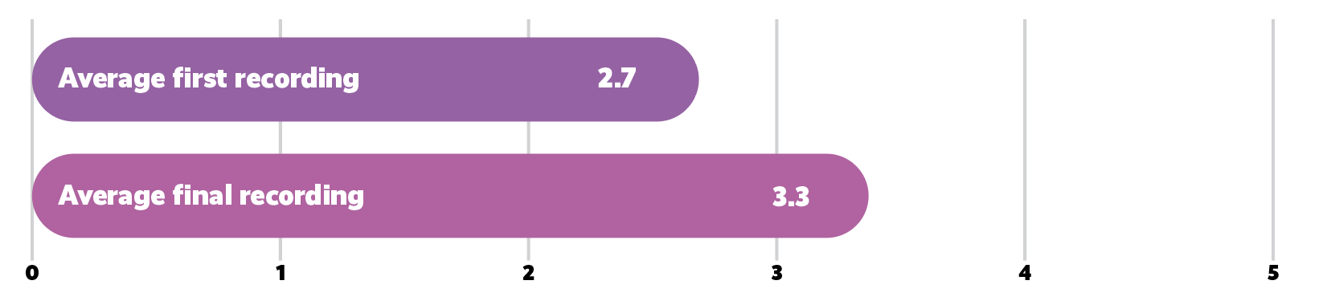
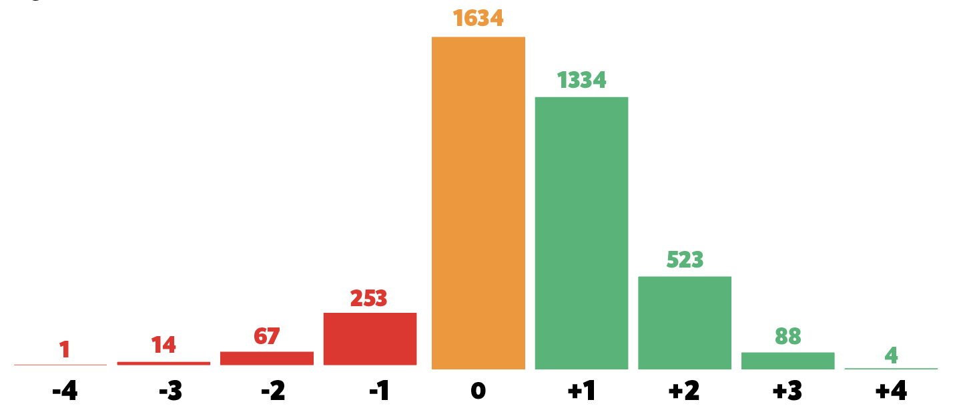
Engagement Levels
Notes:
From Views/Upshot Monitoring data - as at 31/03/23. From 3,710 Engagement Level movement recordings

Slide 11
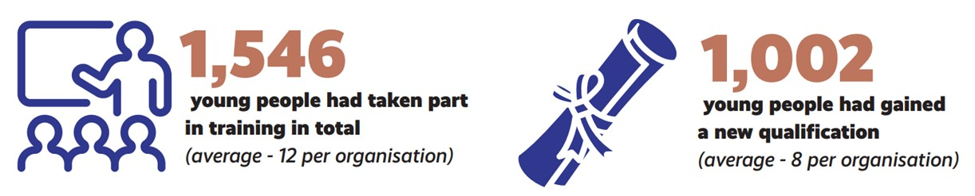
Young People
Training & Qualifications
Notes:
From Project Survey data

